Slide 1





Slide 2
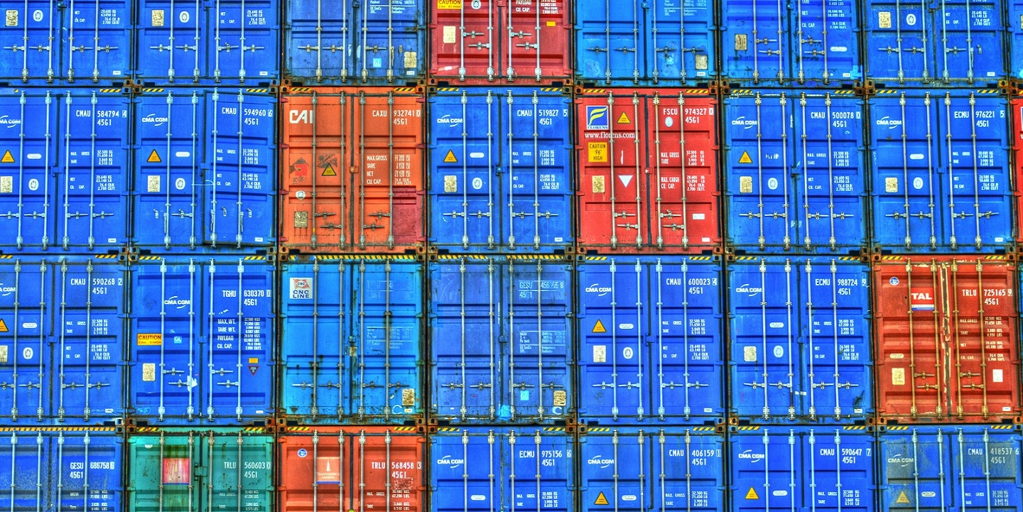
“Globalisation is undoubtedly a force for good”
To what extent do you agree with this statement?
Globalisation is the word used to describe the growing interdependence of the world’s economies, cultures, and populations, brought about by cross-border trade in goods and services, technology, and flows of investment, people, and information. Countries have built economic partnerships to facilitate these movements over many centuries, but the term gained popularity after the Cold War in the early 1990s.
Globalisation defines your everyday lives, it is as relatable, current and topical an issue as any you will find in today’s world. Consider this quote from the great Martin Luther King Jnr:
“Did you ever stop to think that you can’t leave for your job in the morning without being dependent upon most of the world? You get up in the morning and go to the bathroom and reach over for the sponge, and that’s handed you by a Pacific Islander. You reach for a bar of soap, and that’s given to you at the hands of a Frenchman. And then you go into the kitchen to drink your coffee for the morning and that is poured into your cup by a South American. And maybe you want tea: that’s poured into your cup by a Chinese. Or maybe you desire to have cocoa for breakfast, and that’s poured into your cup by a West African. And then you reach over for your toast, and that’s given you at the hands of an English-speaking farmer, not to mention the baker. And before you finish eating breakfast in the morning, you’ve depended on more than half the world. This is the way our universe is structured. It is its interrelated quality. We aren’t going to have peace on earth until we recognize this basic fact of the interrelated structure of all reality.”
He wrote this back in 1967, the world is far more interconnected and interdependent 53 years on!

Slide 3
“Globalisation is undoubtedly a force for good”
To what extent do you agree with this statement?
By the time you’ve completed this project, you will have explored:
What globalisation is.
What drives globalisation.
Who globalisation affects.
How globalisation impacts you and others on the “local” level, both positively and negatively.
How globalisation creates “winners and losers”.
How globalisation can be a force for good socially, economically and environmentally.
How globalisation has been detrimental to people and places socially, economically and environmentally.
“…globalisation is a powerful force that has influenced global growth and development. Driven by the mobility of goods, services, capital, labour and technology, it has brought a large array of new opportunities and benefits. Yet globalisation also has attendant challenges and risks, manifested by imbalances in the distribution of its benefits and costs”
UN Assistant Secretary-General S. Akhtar, 2013.

Slide 4
This is personal…
Before you begin, you must first realise how globalisation affects YOU and those around you:
Making globalisation personal 1 (your house): Take a 5 minute stroll around your house and your mission is to find items of all shapes/sizes/kinds/uses which originate outside of the UK. Make this into a table like this - I’ve begun it with the items around me (don’t judge me!):
Making globalisation personal 2 (your devices): Read this https://www.wired.com/2016/04/iphones-500000-mile-journey-pocket/ and make a flowchart which follows the IPhones' journey right into your pocket in the UK! This still applies even if you do not own an Apple device!
Making globalisation personal 3 (your local area): Read the extract on the following page and write a diary entry similar to this, but detailing your (virtual) walk down your local high street. Use Google Maps’ StreetView feature and take a walk!
Watch these: https://www.youtube.com/watch?v=5SnR-e0S6Ic&t= & https://www.youtube.com/watch?v=s_iwrt7D5OA & https://www.youtube.com/watch?v=9MpVjxxpExM
Item | Country/city of origin | Importance to me
Beikell USB card reader | Shenzhen, China | I need it to transfer the photos from my camera to my laptop.
Lindt Lindor box of chocolates | Induno Olona, Italy | I need them to motivate me to work!
TASK 0

Slide 5
An extract from Doreen Massey’s 1994 A Global Sense of Place:
Take, for instance, a walk down Kilburn High Road, my local shopping centre. It is a pretty ordinary place, north-west of the centre of London. Under the railway bridge the newspaper stand sells papers from every county of what my neighbours, many of whom come from there, still often call the Irish Free State. The postboxes down the High Road, and many an empty space on a wall, are adorned with the letters IRA. Other available spaces are plastered this week with posters for a special meeting in remembrance: Ten Years after the Hunger Strike. At the local theatre Eamon Morrissey has a one-man show; the National Club has the Wolfe Tones on, and at the Black Lion there's Finnegan's Wake. In two shops I notice this week's lottery ticket winners: in one the name is Teresa Gleeson, in the other, Chouman Hassan. Thread your way through the often almost stationary traffic diagonally across the road from the newsstand and there's a shop which as long as I can remember has displayed saris in the window. Four life-sized models of Indian women, and reams of cloth. On the door a notice announces a forthcoming concert at Wembley Arena: Anand Miland presents Rekha, life, with Aamir Khan, Salman Khan, Jahi Chawla and Raveena Tandon. On another ad, for the end of the month, is written, 'All Hindus are cordially invited'. In another newsagents I chat with the man who keeps it, a Muslim unutterably depressed by events in the Gulf, silently chafing at having to sell the Sun. Overhead there is always at least one aeroplane - we seem to have on a flight-path to Heathrow and by the time they're over Kilburn you can see them clearly enough to tell the airline and wonder as you struggle with your shopping where they're coming from. Below, the reason the traffic is snarled up (another odd effect of timespace compression!) is in part because this is one of the main entrances to and escape routes from London, the road to Staples Corner and the beginning of the M1 to 'the North'. This is just the beginnings of a sketch from immediate impressions but a proper analysis could be done of the links between Kilburn and the world. And so it could for almost any place. Kilburn is a place for which I have a great affection; I have lived there many years. It certainly has 'a character of its own'.

Slide 6

Defining globalisation
Before you begin, you must have a clear idea of what is meant by globalisation:
Carry out your own research into the different definitions of globalisation.
When did modern globalisation start?
What is the history of globalisation so far?
How have certain technologies sped up/contributed to globalisation?
Consolidate your research into your own, clear definition and summary of globalisation, making sure to use the word “flow/s” at least once- this will form the introduction of your written assignment. Write up your own definition below using your research:
“The whole of the global economy is based on supplying the cravings of 2% of the world's population”
Bill Bryson.
TASK 1

Slide 7



Technology!
“WINNERS & LOSERS”
It took 1,000 years for the invention of paper to spread from China to Europe. Nowadays, in a world that has become more integrated, innovations spread faster and through many channels.
Globalisation is all about FLOWS, and the flows of ideas and technology are key:
Read: https://blogs.imf.org/2018/04/09/globalization-helps-spread-knowledge-and-technology-across-borders/ and make notes on how the spread of technology has been beneficial.
This article covers 10 medical innovations which are saving lives across the world - https://medicalfuturist.com/the-10-most-innovative-health-technologies-saving-millions-in-the-developing-world/. Read the article, chose 3 and prove how globalisation can be a force for good!
CHALLENGE: https://www.forbes.com/sites/forbestechcouncil/2018/08/23/ai-for-humanity-using-ai-to-make-a-positive-impact-in-developing-countries-2/#f5d94e71b08a
TASK 2

Slide 8
Notes area (1)
Brief notes on what I found interesting: | How this proves globalisation is/is not a force for good:
3 key FFDN (facts/figures/dates/names): 1. 2. 3. | Keywords & their definitions:
Remember to classify into S.E.E!

Slide 9
Technology!
“WINNERS & LOSERS”
Whilst the spread of technology undoubtedly brings with it great rewards, it is not without its disadvantages…
https://thriveglobal.com/stories/why-developing-countries-will-be-left-behind-by-automation/
https://www.weforum.org/agenda/2016/11/in-the-developing-world-two-thirds-of-jobs-could-be-lost-to-robots
https://www.bbc.co.uk/news/business-47852589
https://www.weforum.org/agenda/2018/07/robots-robots-everywhere-what-does-it-mean-for-developing-countries
https://www.bloomberg.com/opinion/articles/2018-09-17/artificial-intelligence-threatens-jobs-in-developing-world
Pick any two of the above articles and consider the following questions as you make notes on the next page:
Why does the spread of technology threaten developing countries?
What solutions can be used to combat this?
Why is the manufacturing industry so important to developing countries?
On balance, do new technologies present more advantages or more disadvantages to developing countries?
TASK 3

Slide 10
Notes area (2)
Brief notes on what I found interesting: | How this proves globalisation is/is not a force for good:
3 key FFDN (facts/figures/dates/names): 1. 2. 3. | Keywords & their definitions:
Remember to classify into S.E.E!

Slide 11
Over to you 1!
Globalisation is a little bit like the whole chicken-egg situation – you are constantly asking yourself: “what came first?”
What came first – the spread of technology? Or globalisation itself?
Did the spread of technology drive globalisation, or did globalisation drive the spread of technology? The truth is that it is a bit of both and you won’t ever get a definitive answer!
Now it’s over to you – you decide the article/YouTube video/website/etc and you can use your own research to complete the below table:
How globalisation drives the spread of technology | How technology drives globalisation
Hints: planes, shipping containers, the Internet etc…

Slide 12
Over to you 2!
Globalisation is a little bit like the whole chicken-egg situation – you are constantly asking yourself: “what came first?”
Now it’s over to you – you decide the article/YouTube video/website/etc and you can use your own research to complete the below table:
How globalisation drives the spread of information | How the flow of information drives globalisation
Hints: Internet, technology, outsourcing etc…

Slide 13


Please submit your note-taking sheets and any other work to: v.lee@parkhighstanmore.org.uk for checking this week.
.

Slide 14
Self-reflection 1
Before progressing any further, this is a good point to take a moment to reflect on your work so far:
How are you researching the positives and negatives of globalisation? What resources are you mostly using and why?
How easy have you found it to carry out your own research?
What view are you forming at the moment – is globalisation a force for good?

Slide 15
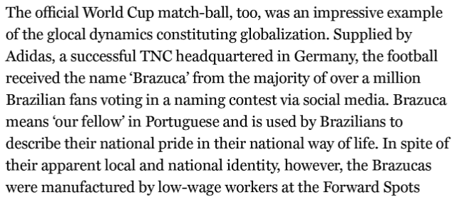
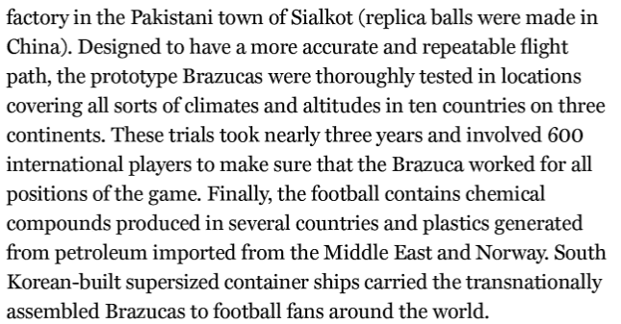
AN ASIDE…
What is fascinating about globalisation is how it is part and parcel of OUR everyday lives. Take this, an extract from “A Very Short Introduction to Globalisation” on the football used in the 2016 FIFA World Cup in Brazil:
HOW DOES THIS PROVE HOW GLOBALISATION IS SO RELEVANT TO YOU AND YOUR FAMILIES?
(..even if you don’t watch football!)

Slide 16

Natural resources! (TNCs)
“WINNERS & LOSERS”
TNCs, or transnational corporations, are huge drivers of globalisation. By their very nature, they are able to establish themselves and operate in more than one country. Usually, a TNC will have its headquarters (where most of its tertiary and quaternary jobs will be based) in a HIC, and its manufacturing (secondary) based in an LIC or NEE (NIC).
Whilst TNCs do bring with them many social and economic advantages, this often comes at the expense of the environment (and this then has knock-on social and economic ramifications).
Use four of the following links and your own research to look into Coca-Cola’s record of water abstraction in developing countries and the criticism it has received:
https://waronwant.org/media/coca-cola-drinking-world-dry
https://www.youtube.com/watch?v=RWSjWWsFy9g
https://www.youtube.com/watch?v=3wrpxfCJ_EA
https://www.theguardian.com/money/2006/mar/19/business.india1
https://www.theguardian.com/environment/2014/jun/18/indian-officals-coca-cola-plant-water-mehdiganj
https://www.thoughtco.com/coca-cola-groundwater-depletion-in-india-1204204
https://corpwatch.org/article/coca-cola-forced-shut-bottling-plant-india
https://www.business-humanrights.org/en/india-13-years-after-shut-down-of-bottling-plant-in-kerala-villagers-allege-they-dont-have-clean-drinking-water-waiting-for-justice-for-effects-of-pollution
https://www.independent.co.uk/news/world/americas/coca-cola-mexico-wells-dry-bottled-water-sucking-san-felipe-ecatepec-chiapas-a7953026.html
https://www.theverge.com/2018/5/31/17377964/coca-cola-water-sustainability-recycling-controversy-investigation
CHALLENGE: pgs14-22 of http://fivas.org/wp-content/uploads/2015/05/fivas_Dead-in-the-water_skjerm.pdf
TASK 4

Slide 17
Notes area (3)
Brief notes on what I found interesting: | How this proves globalisation is/is not a force for good:
3 key FFDN (facts/figures/dates/names): 1. 2. 3. | Keywords & their definitions:
Remember to classify into S.E.E!

Slide 18
Over to you 3!
Globalisation is a little bit like the whole chicken-egg situation – you are constantly asking yourself: “what came first?”
Now it’s over to you – you decide the article/YouTube video/website/etc and you can use your own research to complete the below table:
How globalisation drives the spread of products & services | How the flow of products & services drives globalisation
Hints: TNCs, internet, tertiary, etc…

Slide 19
ANOTHER ASIDE…
As a momentary distraction – take a look at this anecdote which people use to illustrate globalisation – it concerns the death of Princess Diana, Dodi Fayed and their driver in 1997:
“An English princess with an Egyptian boyfriend crashes in a French tunnel, riding in a German car with a Dutch engine, driven by a Belgian who was (allegedly) drunk on Scottish whisky, followed closely by Italian paparazzi riding Japanese motorcycles. Then treated by an American doctor, using Brazilian medicines. This is sent to you by an Englishman, using Bill Gates' (American) technology, and you're probably reading this on your computer that uses Taiwanese chips and a Korean monitor, assembled by Bangladeshi workers in a Singapore plant, transported by Eastern European lorry-drivers…”
WHY IS THIS A GOOD ILLUSTRATION OF WHAT GLOBALISATION IS?

Slide 20

The BRAIN drain!
“WINNERS & LOSERS”
The flow of people again brings up the chicken-egg situation – what drives what?
Either way, it is clear that globalisation makes the movement of people around the world much easier. Not only can people travel really easily, they also remain connected to loved ones back home through technology which, for example, lets them communicate (e.g. WhatsApp, Skype, etc…) or which allows money transfer (e.g. PayPal or Western Union).
Making travel for work so easy and attractive has led to what we refer to as a brain drain: the emigration of highly trained or qualified people from a particular country. Countries around the world are competing for resources and prime among these is human capital (the skills, knowledge, and experience possessed by an individua). Attracted by a better standard of living and the promise of higher wages, skilled individuals are leaving their countries in search of opportunities elsewhere. When this individual is from a developing country, this can be especially damaging…
Use four of the following links and your own research to look into the brain drain and its social and economic impacts on both developed and developing countries:
https://www.youtube.com/watch?v=5IUcFDE3COc
https://www.youtube.com/watch?v=msaTfbWGc9g
https://www.dw.com/en/my-europe-eastern-brain-drain-threatens-all-of-eu/a-46755913
https://www.channelnewsasia.com/news/commentary/brain-drain-hong-kong-taiwan-singapore-aspirations-identity-10314388
https://www.onlineuniversities.com/blog/2011/07/10-countries-facing-the-biggest-brain-drain/
https://en.wikipedia.org/wiki/Human_capital_flight#Africa
https://blogs.lse.ac.uk/africaatlse/2016/01/18/how-severe-is-africas-brain-drain/
https://www.theguardian.com/world/2019/apr/21/romanian-hospitals-in-crisis-as-emigration-take-its-toll
https://www.youtube.com/watch?v=uBPreIqYOMQ
https://www.youtube.com/watch?v=-mhe7COLiR0
TASK 5

Slide 21
Notes area (4)
Brief notes on what I found interesting: | How this proves globalisation is/is not a force for good:
3 key FFDN (facts/figures/dates/names): 1. 2. 3. | Keywords & their definitions:
Remember to classify into S.E.E!

Slide 22
Please submit your note-taking sheets and any other work to: v.lee@parkhighstanmore.org.uk for checking this week.
.

Slide 23
Self-reflection 2
Before progressing any further, this is a good point to take a moment to reflect on your work so far:
How are you researching the positives and negatives of globalisation? What resources are you mostly using and why?
How easy have you found it to carry out your own research?
What view are you forming at the moment – is globalisation a force for good?

Slide 24
The BRAIN gain!
“WINNERS & LOSERS”
Whilst the immigration of skilled people presents an issue for their origin country, their host country benefits. This is known as the brain GAIN: the benefit to a country as a result of the immigration of a highly qualified person.
Use the below link to make Cornell notes –this will be a new way of making notes and will seem tough at first, however it is by far the best way to make notes at A-level - use the second link to find out how to do this and you will find templates in the following pages:
https://www.ucl.ac.uk/news/2014/nov/positive-economic-impact-uk-immigration-european-union-new-evidence
https://www.youtube.com/watch?v=WtW9IyE04OQ
TASK 6

Slide 25

Remittances!
“WINNERS & LOSERS”
Whilst the movement of skilled individuals away from developing countries can be damaging, they do often send back remittances, which is money sent back by a migrant to his/her family ‘back home’.
Use the links below to make TWO pages Cornell notes – use the final link to find out how to do this and you will find templates on the following pages:
https://www.un.org/development/desa/en/news/population/remittances-matter.html
https://qz.com/africa/848447/gift-remitting-somalis-in-the-diaspora-send-1-4-billion-in-cash-remittances-every-year/
https://www.youtube.com/watch?v=WtW9IyE04OQ
TASK 7

Slide 26
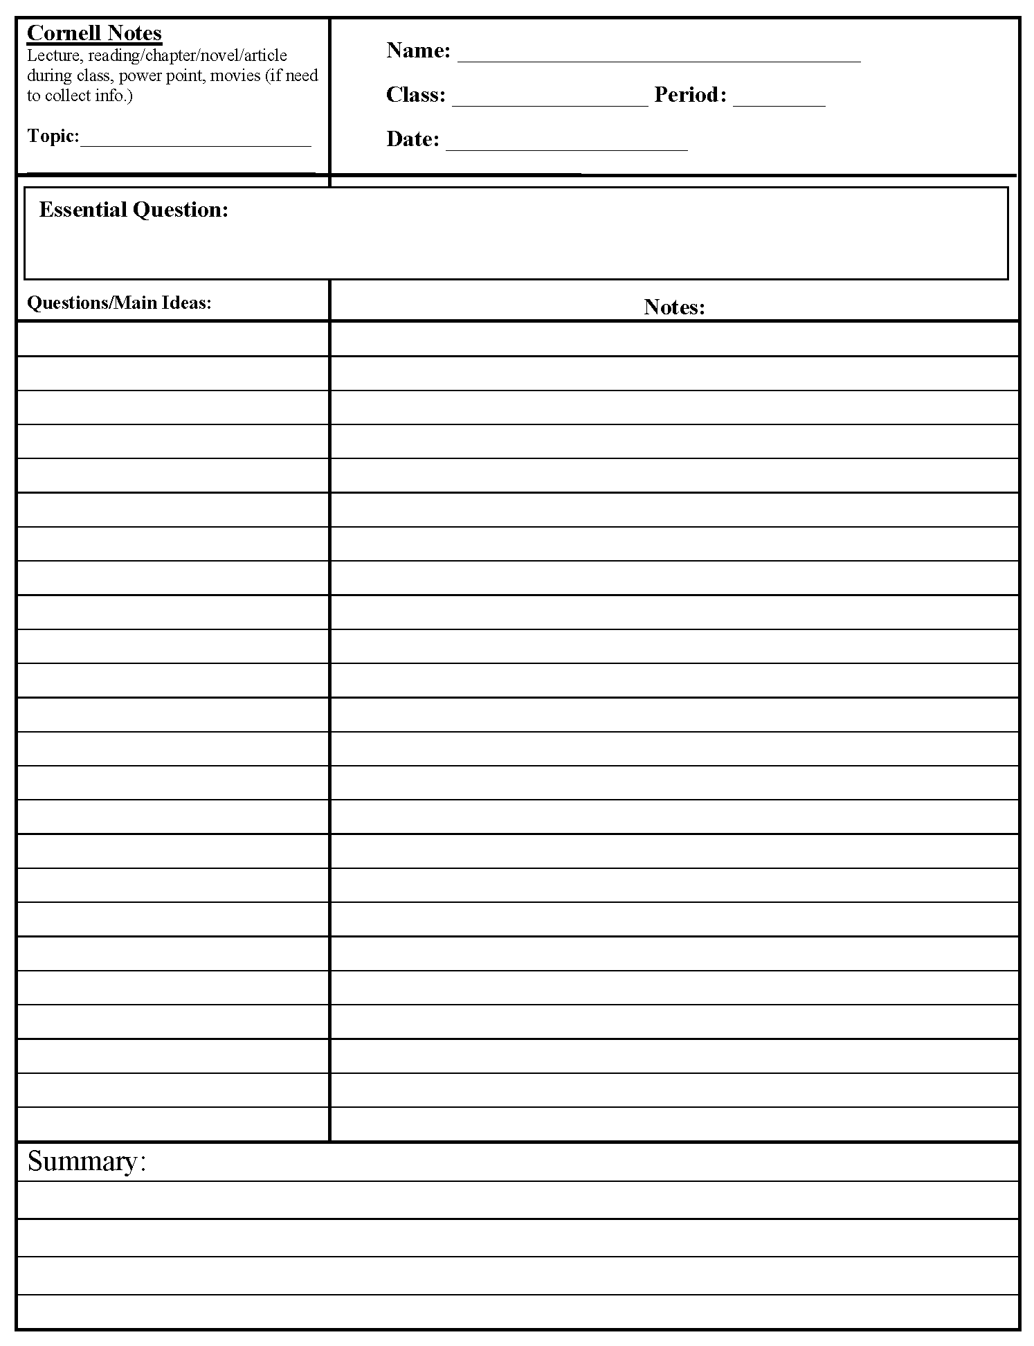

Slide 28
Over to you 4!
Globalisation is a little bit like the whole chicken-egg situation – you are constantly asking yourself: “what came first?”
Now it’s over to you – you decide the article/YouTube video/website/etc and you can use your own research to complete the below table:
How globalisation drives the flow of capital | How the flow of capital drives globalisation
Hints: TNCs, investment (FDI), etc…

Slide 29
Adding more depth…
“WINNERS & LOSERS”
The following extract comes from an OECD report – use it to your notes on the benefits of remittances in a globalised world:
There are some indisputable welfare effects of migrant remittances. First, remittances are an important source of income for many low and middle-income households in developing countries. Second, remittances provide the hard currency needed for importing scarce inputs that are not available domestically and also additional savings for economic development (Ratha, 2003; Taylor, 1999; Quibria, 1997). But the magnitude of the development impact of remittances on the receiving countries was assumed by many scholars to depend on how this money was spent. Thus, a significant proportion of the literature studies the use of remittances for consumption, housing, purchasing of land, financial saving and productive investment. There is no doubt that spending on entrepreneurial investment has a positive direct effect on employment and growth.6 However, other scholars documented that even the disposition of remittances on consumption and real estate may produce various indirect growth effects on the economy. These include the release of other resources to investment and the generation of multiplier effects. Regarding the use of migrant remittances, a longstanding literature has suggested that remittances are more often spent on basic consumption needs, health care and real estate. But, whether from remittances or other sources, income is spent in a way which responds to the hierarchy of needs. Therefore it is reasonable to suppose that until the developing countries reach a certain level of welfare, households will continue to exhibit the same spending pattern (Lowell and de la Garza, 2000). A more significant aspect concerning the use of remittances questions whether they are spent in a different way than other sources of income. There is empirical evidence that households with remittances have similar consumption patterns to households not receiving remittances. Yet other scholars suggest that remittances are treated differently than other sources of income and are more often saved. Household surveys in Pakistan show that a larger part of international remittances are saved (71%) compared to domestic urban-rural remittances (49%) and rental income (8.5%) (Adams, 1998). In other countries, for example Mali, remittances are used to build schools and clinics (Martin and Weil, 2002). But the decisions of remittance senders (or receivers) to invest more or less is a rational choice about the use of their income, according to the general economic situation in their countries. Household productive investments do not depend on income, but rather on interest rates, stock prices, sound macroeconomic policies and stable economic growth (Puri and Ritzema, 1999). Recent economic research shows that remittances, even when not invested, can have an important multiplier effect. One remittance dollar spent on basic needs will stimulate retail sales, which stimulates further demand for goods and services, which then stimulates output and employment (Lowell and de la Garza, 2000).
TASK 8

Slide 30
Over to you 5!
Globalisation is a little bit like the whole chicken-egg situation – you are constantly asking yourself: “what came first?”
Now it’s over to you – you decide the article/YouTube video/website/etc and you can use your own research to complete the below table:
How globalisation drives the flow of labour | How the flow of labour drives globalisation
Hints: free movement areas (EU), spread of culture (i.e. food), etc…

Slide 31

Global shift!
“WINNERS & LOSERS”
The ‘global shift’ is a consequence of globalisation and the increase of foreign direct investment by TNCs in newly industrialising countries (NEEs – these include the Asian Tigers – South Korea, Taiwan, Singapore and Hong Kong, which started industrialising in the 1960s – and China and India) and recently industrialising countries (these include the Philippines, Indonesia and Cambodia; countries which began industrialising in the 1980s).
Global shift means an increase in proportion of global manufacturing carried out in NEEs in the last 30 years. The majority of this is happening in Asia. Global shift has led to deindustrialisation in key industrial areas in the UK (South Wales, for example) and combined with outsourcing (when a company hires another individual to perform tasks) has led to huge job losses in developed countries.
Use four of the following links and your own research to look into the global shift and outsourcing and its negative economic impacts worldwide:
https://www.thebalance.com/how-outsourcing-jobs-affects-the-u-s-economy-3306279
https://www.bbc.co.uk/news/business-38600270
https://ftalphaville.ft.com/2016/12/06/2180771/how-many-us-manufacturing-jobs-were-lost-to-globalisation/
https://www.epi.org/publication/china-trade-outsourcing-and-jobs/
https://www.theguardian.com/world/2009/nov/01/detroit-michigan-economy-recession-unemployment
https://www.governing.com/commentary/gov-legacy-city-struggling-cities.html
https://www.ft.com/content/b2751878-c10d-11e5-846f-79b0e3d20eaf
https://www.theguardian.com/business/2019/may/29/redcar-how-the-end-of-steel-left-a-tragic-legacy-in-a-proud-town
https://www.economicshelp.org/blog/27657/unemployment/structural-unemployment/
TASK 9

Slide 32
Notes area (5)
Brief notes on what I found interesting: | How this proves globalisation is/is not a force for good:
3 key FFDN (facts/figures/dates/names): 1. 2. 3. | Keywords & their definitions:
Remember to classify into S.E.E!

Slide 33
Please submit your note-taking sheets and any other work to: v.lee@parkhighstanmore.org.uk for checking this week.
.

Slide 34
Self-reflection 3
Before progressing any further, this is a good point to take a moment to reflect on your work so far:
How are you researching the positives and negatives of globalisation? What resources are you mostly using and why?
How easy have you found it to carry out your own research?
What view are you forming at the moment – is globalisation a force for good?

Slide 35
Outsourcing!
“WINNERS & LOSERS”
The outsourcing of jobs is a contentious issue – whilst it does “take” from end of the world, it does then “give” to another. A job in software engineering “lost” to an American worker is “gained” by an Indian worker.
Use four of the following links and your own research to look into the outsourcing and its positive economic impacts worldwide:
https://outsourcingangel.com/how-does-outsourcing-help-developing-countries/
https://www.dailysabah.com/opinion/2014/06/17/is-outsourcing-a-chance-for-developing-countries
https://www.forbes.com/sites/morganhartley/2012/12/16/the-culture-shock-of-indias-call-centers/#1f84953972f5 – India’s call centre workers, who massively benefit from outsourcing.
https://www.theguardian.com/sustainable-business/2014/jun/19/outsourcing-extreme-poverty-africa-south-asia-call-centres-ddd
http://college.cengage.com/polisci/duncan/world_politics_sce/1e/assets/students/case/duncan_1e_case_ch13.pdf
http://www.outsourcingportal.eu/en/how-can-outsourcing-drive-economic-growth
TASK 10

Slide 36
Notes area (6)
Brief notes on what I found interesting: | How this proves globalisation is/is not a force for good:
3 key FFDN (facts/figures/dates/names): 1. 2. 3. | Keywords & their definitions:
Remember to classify into S.E.E!

Slide 37

Worker exploitation! (TNCs)
“WINNERS & LOSERS”
TNCs, or transnational corporations, are huge drivers of globalisation. One major criticism of TNCs from a social perspective, however, is their poor treatment of workers in NEEs.
Use three of the following links and your own research to look into the exploitation of workers worldwide by TNCs:
https://www.theguardian.com/technology/2011/apr/30/apple-chinese-factory-workers-suicides-humiliation
https://www.youtube.com/watch?v=3tf6qc51Kbw
https://www.theguardian.com/technology/2017/jun/18/foxconn-life-death-forbidden-city-longhua-suicide-apple-iphone-brian-merchant-one-device-extract
https://www.theguardian.com/business/2017/jun/25/female-cambodian-garment-workers-mass-fainting
https://www.investopedia.com/terms/r/race-bottom.asp
https://www.youtube.com/watch?v=kSvT02q4h40
https://qz.com/1042298/nike-is-facing-a-new-wave-of-anti-sweatshop-protests/
https://waronwant.org/sites/default/files/Adidas%20briefing.pdf
https://www.youtube.com/watch?v=M5uYCWVfuPQ
https://www.theguardian.com/uk/2000/nov/19/jasonburke.theobserver
https://www.independent.co.uk/news/world/asia/factory-workers-are-forced-to-lie-during-adidas-safety-inspections-7644018.html
TASK 11

Slide 38
Notes area (7)
Brief notes on what I found interesting: | How this proves globalisation is/is not a force for good:
3 key FFDN (facts/figures/dates/names): 1. 2. 3. | Keywords & their definitions:
Remember to classify into S.E.E!

Slide 39

Globalisation = peace!
“WINNERS & LOSERS”
Globalisation seems to have ushered in an era of increased global coherence and cooperation. We are “around the table” more and better trade relationships make the prospect of war much more unattractive. After all, why fight with, say, your major smartphone supplier?
Use any of the links below and your own research to look into how globalisation has promoted global peace since 1945:
Be wary, this idea isn’t accepted by all and some argue that not being at war does not mean you are at peace! Many point to US-Russia and US-China as great examples of highly globalised nations which are in constant (non-combat) conflict.
https://voxeu.org/article/globalisation-promotes-peace
https://www.youtube.com/watch?v=VyyCTKosPOA
https://en.wikipedia.org/wiki/Capitalist_peace
https://www.youtube.com/watch?v=N-JOOdZO0mE
https://www.ft.com/content/1413fc26-f4c6-11e4-9a58-00144feab7de
https://mediawiki.middlebury.edu/IPE/Golden_Arches_Theory_of_Conflict_Prevention
https://foreignpolicy.com/2013/12/02/does-globalization-mean-war/
https://www.vision.org/society-and-culture-globalization-politics-and-religion-375
https://www.globalpolicy.org/social-and-economic-policy/international-trade-and-development-1-57/general-analysis-on-international-trade-and-development/47297-does-globalization-bring-war-or-peace.html
“No two countries that both had McDonalds had fought a war against each other since each got its McDonalds” Thomas Friedman.
TASK 12

Slide 40
Notes area (8)
Brief notes on what I found interesting: | How this proves globalisation is/is not a force for good:
3 key FFDN (facts/figures/dates/names): 1. 2. 3. | Keywords & their definitions:
Remember to classify into S.E.E!

Slide 41

The environment!
“WINNERS & LOSERS”
Use the link below to make TWO pages of Cornell notes: One page on the negative environmental impacts of globalisation and one page on how globalisation may be help in environmental protection. Use the final link to find out how to do this and you will find templates in the following pages:
https://www.oecd-ilibrary.org/docserver/9789264111905-8-en.pdf?expires=1586433496&id=id&accname=guest&checksum=9EBF10A50A68317360546F85A39D1B00 – Chapter 7
https://www.youtube.com/watch?v=WtW9IyE04OQ (There is also an explanation on the A-level transition work Geography Page)
TASK 13

Slide 44
The environment!
“WINNERS & LOSERS”
TNCs, or transnational corporations, are huge drivers of globalisation. One major criticism of TNCs from an environmental perspective, however, is their degradation and destruction of the local environment in the countries in which they operate.
Use the following links and your own research to investigate the negative environmental impacts of globalisation worldwide:
https://www.environment.co.za/environmental-issues/globalization-and-its-impact-on-the-environment.html
https://wedocs.unep.org/rest/bitstreams/17293/retrieve
https://www.thebrokeronline.eu/the-race-to-the-bottom-explained-d55/
https://news.mongabay.com/2008/08/corporations-become-prime-driver-of-deforestation-providing-clear-target-for-environmentalists/
On meat consumption (something that is blamed on the spread of Western culture which actively encourages a more lavish, consumerist and extravagant lifestyle): https://www.weforum.org/agenda/2018/08/global-appetite-for-meat-is-growing/ + https://foodindustry.asia/the-impact-of-globalisation-urbanisation-and-rising-incomes-on-consumption + https://www.theguardian.com/environment/2018/jul/19/rising-global-meat-consumption-will-devastate-environment
CHALLENGE: However, some argue that globalisation may actually help some countries to become more sustainable! https://ec.europa.eu/environment/integration/research/newsalert/pdf/169na2_en.pdf + https://theconversation.com/globalization-may-actually-be-better-for-the-environment-95406
TASK 14

Slide 45
Notes area (9)
Brief notes on what I found interesting: | How this proves globalisation is/is not a force for good:
3 key FFDN (facts/figures/dates/names): 1. 2. 3. | Keywords & their definitions:
Remember to classify into S.E.E!

Slide 46
The environment!
“WINNERS & LOSERS”
Globalisation seems to have ushered in an era of increased global coherence and cooperation. We are “around the table” more and political globalisation seems to be taking place: The creation and existence of the United Nations is called one of the classic examples of political globalisation. Environmental globalisation is another important facet of this. It refers to the internationally coordinated practices and regulations (often in the form of international treaties) regarding environmental protection. An example of environmental globalization would be the series of International Tropical Timber Agreement treaties (1983, 1994, 2006), establishing International Tropical Timber Organization and promoting sustainable management of tropical forests.
Together, we are doing a lot more to save and protect the environment – 2015’s Paris Agreement was a good example of this. The work of NGOs would be much harder to conduct in a less globalised world where they might have less support from members of the public (e.g. Greenpeace petitions).
Use the following links and your own research to investigate how (political) globalisation is helping to protect and preserve the environment.
https://ec.europa.eu/environment/integration/research/newsalert/pdf/169na2_en.pdf
https://theconversation.com/globalization-may-actually-be-better-for-the-environment-95406
https://www.dummies.com/education/science/environmental-science/what-international-agreements-exist-to-protect-the-environment/
https://ec.europa.eu/environment/international_issues/agreements_en.htm
https://en.wikipedia.org/wiki/Environmental_globalization
https://oecdobserver.org/news/fullstory.php/aid/2240/Innovation,_globalisation_and_the_environment.html
https://www.wur.nl/en/newsarticle/A-better-global-environment-through-globalisation.htm
TASK 15

Slide 47
Over to you 6!
Some countries have benefitted massively from globalisation and using a located example (case study) approach in one paragraph/section of your essay might be a good idea. Some argue HICs are the real winners but good examples which debate this theory include India, South Korea and China.
https://www.weforum.org/agenda/2018/06/chart-of-the-week-distribution-of-globalization-s-gains
https://www.economist.com/graphic-detail/2020/02/27/countries-that-have-benefited-most-from-globalisation-are-the-most-fearful-of-change
https://www.livemint.com/Money/cNmmQJZdnMhbk3Ydbs26wI/Which-countries-have-benefited-the-most-from-globalization.html
https://ged-project.de/research/studies/globalization-report-2018-who-benefits-most-from-globalization/
https://www.bertelsmann-stiftung.de/en/press/press-releases/press-release/pid/advanced-economies-benefit-from-globalization-much-more-than-developing-countries-and-nics/
Now it’s over to you – you decide the articles/YouTube videos/websites/etc and you can use your own research to complete the below table:
Hints:
Multiplier effect, tax revenue, increased trade, disposable income, etc…

Slide 48
Over to you 6!
Social benefits | Economic benefits
Any negative impacts which might serve as a good counter-argument:

Slide 49
Please submit your note-taking sheets and any other work to: v.lee@parkhighstanmore.org.ukfor checking this week.
.

Slide 50
Over to you 7!
This is the final task before your plan, so I want to give you a chance to look into some of the parts of the globalisation debate not yet covered.
Now it’s over to you – you decide the articles/YouTube videos/websites/etc and you can use your own research to look into the above & complete the below table:
Globalisation is a force for good | Globalisation is not a force for good
TNCs do provide higher wages to workers in the developing world. TNCs can create a multiplier effect (e.g. when they set up factories). Organisations like the UN have helped developing countries to develop. The spread of culture. Flow of economic migrants. Free trade has led to economic growth in many NEEs. | The de-multiplier effect caused by deindustrialisation (e.g. ghost town). Cultural erosion (Westernisation/cultural imperialism). Local, small businesses out-completed by TNCs. Income inequality. Carbon emissions.
https://www.youtube.com/watch?v=12YDLZq8rT4&t=
Globalisation is a force for good | Globalisation is not a force for good

Slide 51
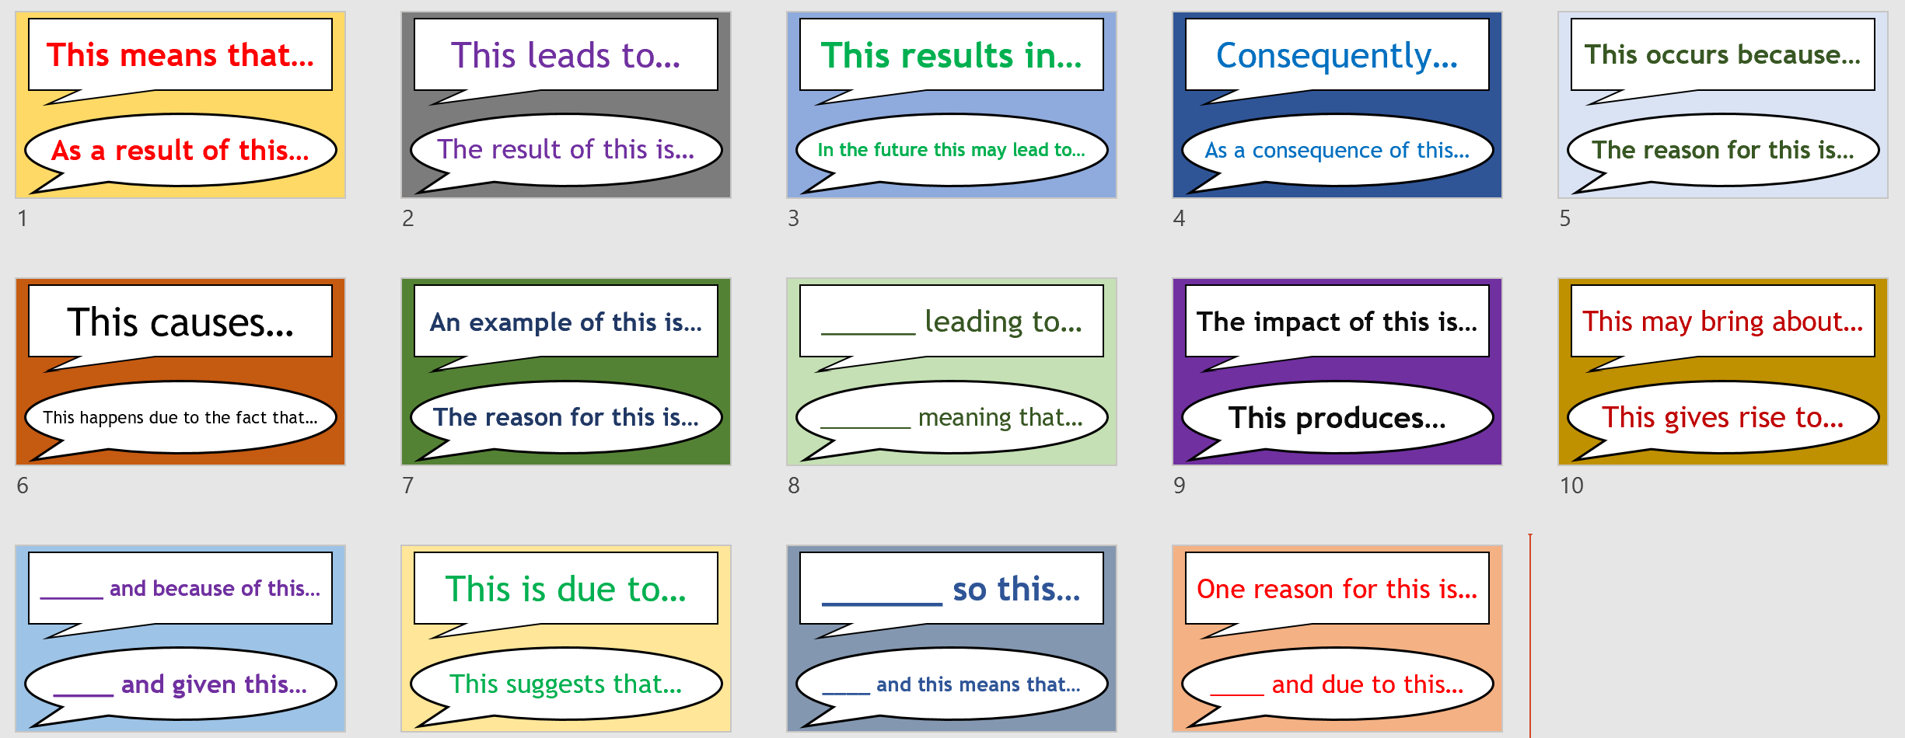
The plan!
You have taken a journey through both sides of the globalisation argument and you now need to carefully plan your essay.
This task will need to be submitted to v.lee@parkhighstanmore.org.uk for feedback, and you should not start writing up your final piece until you have received feedback on your plan. Planning your answers is a crucial part in essay writing and you need to hone this skill early on!
Complete the table on the next page, thinking carefully about the arguments you will make as well as the key FFDN you will use to support these, and then submit to Ms Lee.
Just remember, you do not have to issue a blanket statement: “I agree fully” or “I do not agree at all” – Geography is a little more complicated than that: Even if you agree with the statement, you could argue globalisation is not a force for good everywhere nor for everyone (winner and losers).
Phrases you may want to use throughout your essay:

Slide 52
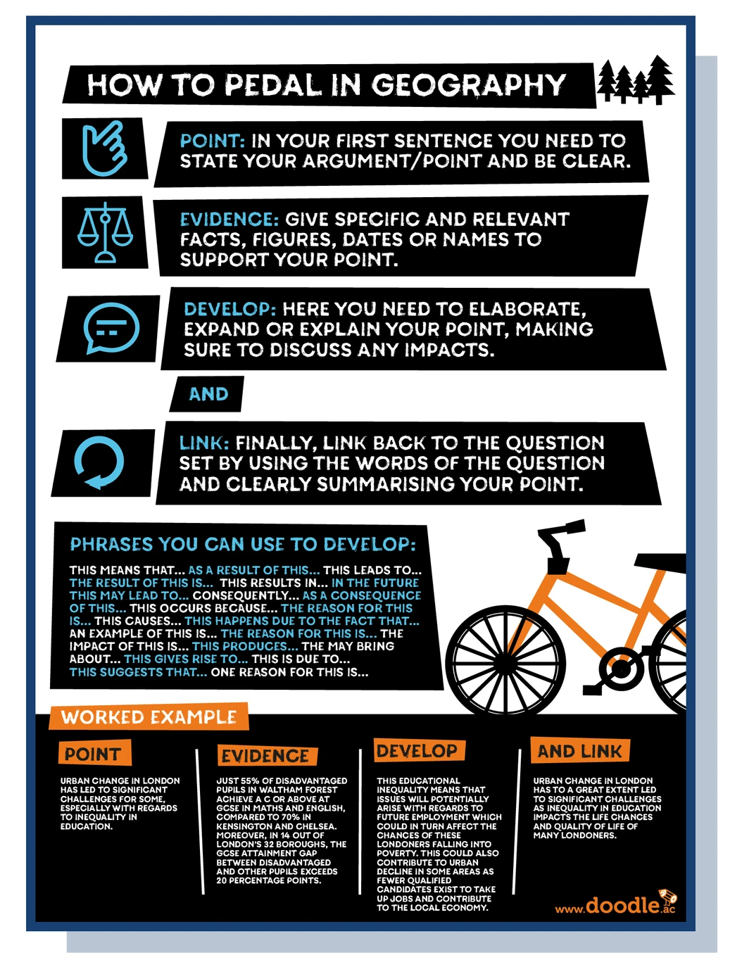
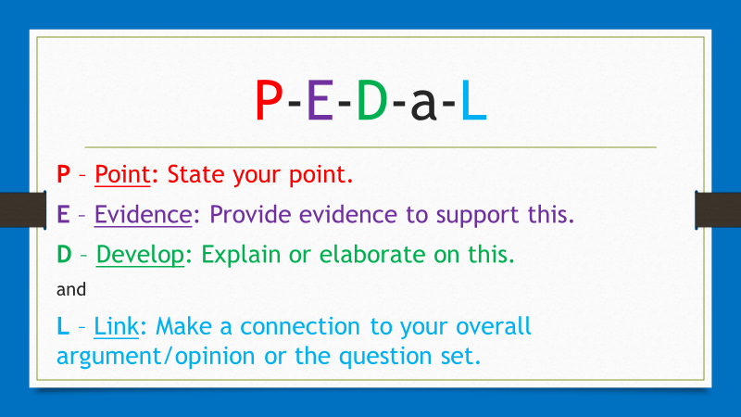
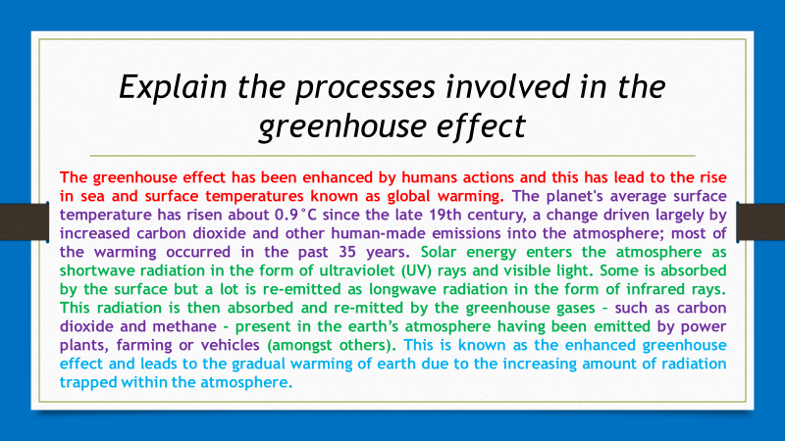
Tips & PEDaL
Use the following to help you during the planning stages:
PEDaL:
PEDaL stands for Point, Evidence, Develop and Link. You could use this to structure your paragraphs.
2. General tips:
A paragraph contains one idea. The idea is generally introduced in the first sentence, discussed throughout the paragraph and resolved in the final sentence. A sentence is not a paragraph – although there are occasional exceptions to this rule. There needs to be a logical, well-structured flow of your paragraphs and argument as a whole, where the final sentence of the paragraph leads the reader logically into the next paragraph. You need to avoid jumping from one issue to another, and back. Each paragraph should link back to the main topic and support the argument being made.
Ensure that everything being said relates back to the main question/argument, if it does not, it should not be included - quality over quantity.
Make sure you are forming and presenting your own opinion through academic research, rather than just relaying the information.
Ensure paragraphs stick to one idea/point and do not make them too long. There is no set limit. However, quality over quantity is important here as well.

Slide 53
Intro. | Define globalisation State your opinion in relation to the question | Academic language you will use throughout: Conversely… Nevertheless…
1 | AGREE with the statement: YOU COULD SPLIT THIS INTO TWO MINI PARAGRAPHS | Key FFDN you will include:
2 | DISAGREE with the statement: YOU COULD SPLIT THIS INTO TWO MINI PARAGRAPHS | Key FFDN you will include:
3 | AGREE/DISAGREE with the statement – here you must pick whichever side of the argument you side with most strongly: | Key FFDN you will include:
Conc. | Recap your arguments and end by directly answer the question- Pull the various strings of your argument together and relate it back to your introduction whilst covering what has been discussed in the essay.

Slide 54
Essay time!
Using the previous guidance sheets, and your plan (your notes if you need to), you are now ready to write up your final answer to the question – it should be about 1,500 words in length.
However do not get obsessed with the word count. It is much better to just write the essay! (For general guidance, font size 12 Arial, single spaced is 3.3 pages of typed text [4.2 if you space it 1.5lines-this is preferable] Hand written the number of words per page varies from 150 for large-handwriting to 300 for small, so 5-10 pages)
Your essay is due your first lesson in September!
“Globalisation is undoubtedly a force for good”
To what extent do you agree with this statement?

