Slide 1
Media Studies
Getting ready for
A Level study
You can complete the set tasks using the slides below or use your own Word document or even handwrite your responses if computer access is limited.

Slide 2
Getting started: What is Media Studies?
Complete – Answer the questions using the information from the video
https://www.youtube.com/watch?v=qE-B_XkoAgQ
What is Media Language? Answer using the words ‘codes’, ‘denotation’, ‘connotation’ and give at least one example.
What is ‘representation’? Give at least one example.
Why is the concept of audience so important? Give an example.
What do we mean by media institutions and why is it key to consider the media industries to understand media texts? Give an example.

Slide 3
Weeks 1-2: Understanding Media Language

Slide 4
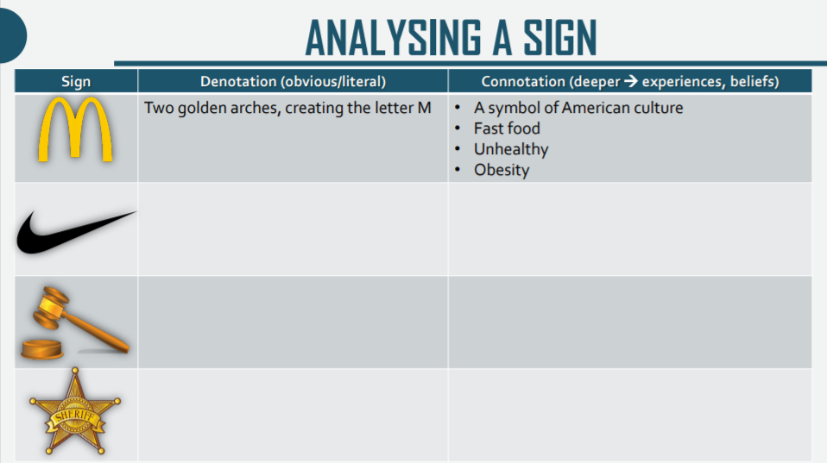
Semiotics - Analysing a sign
McDonalds – see example
Second sign
  Denotation:
  Connotation:
C. Third sign
  Denotation:
  Connotation
D. Fourth sign
  Denotation:
  Connotation

Slide 5
Star Wars sequence – Meanings created by the Media Language choices (200-300 words) https://www.youtube.com/watch?v=rgyitSlMtMY
You may choose to use some of the phrases below.
The sequence is climactic as we witness a confrontation between…
The camerawork helps to heighten the tension. For example, ….
Another example is the …. (shot / angle) which creates….
The editing also adds to the tension, for example the juxtaposition of shots such as….
The use of Close-Ups also allows the audience to feel …. For example, …
The climax is achieved through the dialogue when… To enhance the effect of this powerful moment, the producers have used….

Slide 6
Practical work

Slide 7
Week 3: Understanding Representation

Slide 8
Marvel and Gender Representation
Watch, read and answer questions:
1. In this clip, how are men represented? How are women represented? Think about themes, settings, costumes, gender roles, dialogue, narrative (aim for 150 words minimum)
https://youtu.be/dNPkJ7eEVDU
2. Does Marvel have a gender inequality problem?
https://youtu.be/LIvZEk30FsY
This serves as an introduction before the article on the next two pages (of the booklet)
Bullet point two or three key points made in this video.

Slide 9
Article: ‘Avengers: Age of Ultron’s’ Black Widow Disgrace (May 05, 2015)
Answer the following questions:
What is the central argument made in this article?
How is ‘Hollywood’s reluctance to make a superhero film with a female hero in the lead’ explained?
In what ways is the sequence introducing Romanoff / Black Widow problematic in terms of gender representations? Which stereotypes of femininity are deployed?
How is her character developed in subsequent sequences and films?
What do we learn about the institution (studios, in this case) behind such decisions – including the question of merchandises?

Slide 10
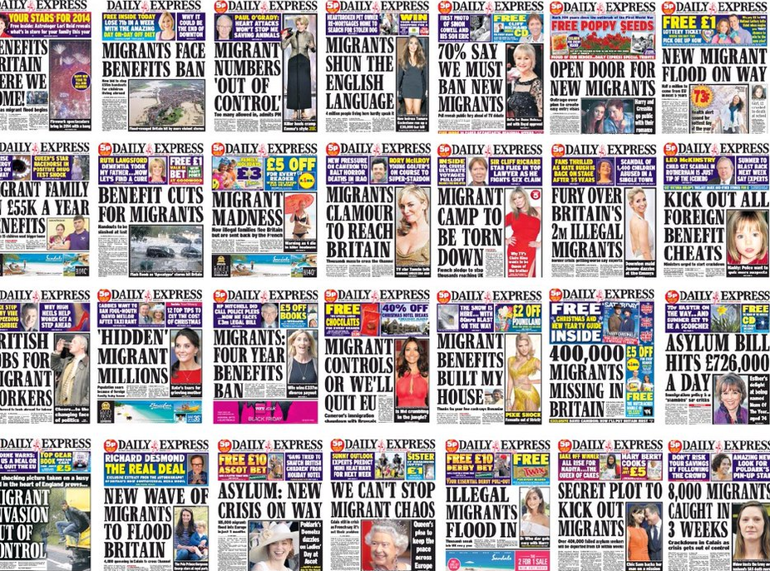
Representation of issues and social groups
Answer: What do you think are the possible consequences of repeated messages about certain social groups in newspaper front pages such as in the Daily Express’ emotive and biased pages below

Slide 11
Representation of immigrants
Watch and answer the questions below:
Cecilia Menjívar, a KU Foundation Distinguished Professor of Sociology, speaks about her report into the effects of such problematic media representations of immigrants in this video: https://www.youtube.com/watch?v=zPSB-71Cua4 and the linked article: NEGATIVE MEDIA PORTRAYALS DRIVE PERCEPTION OF IMMIGRATION POLICY, STUDY FINDS
‘We find that media have a central place in shaping the public's views of immigrants and immigration but also on shaping the immigrants’ views of themselves in relation to others.’
"The more a message is repeated — in this case in the news media — it becomes a 'fact' even if it is not true. And most sensationalist one-liners are not accurate," she said. "But because most people can't do the research themselves, their only source of information are these messages, told over and over again.“
Q: What effects have these messages had on the immigrants’ behaviours according to the report?

Slide 12
Week 4: Understanding Audience

Slide 13
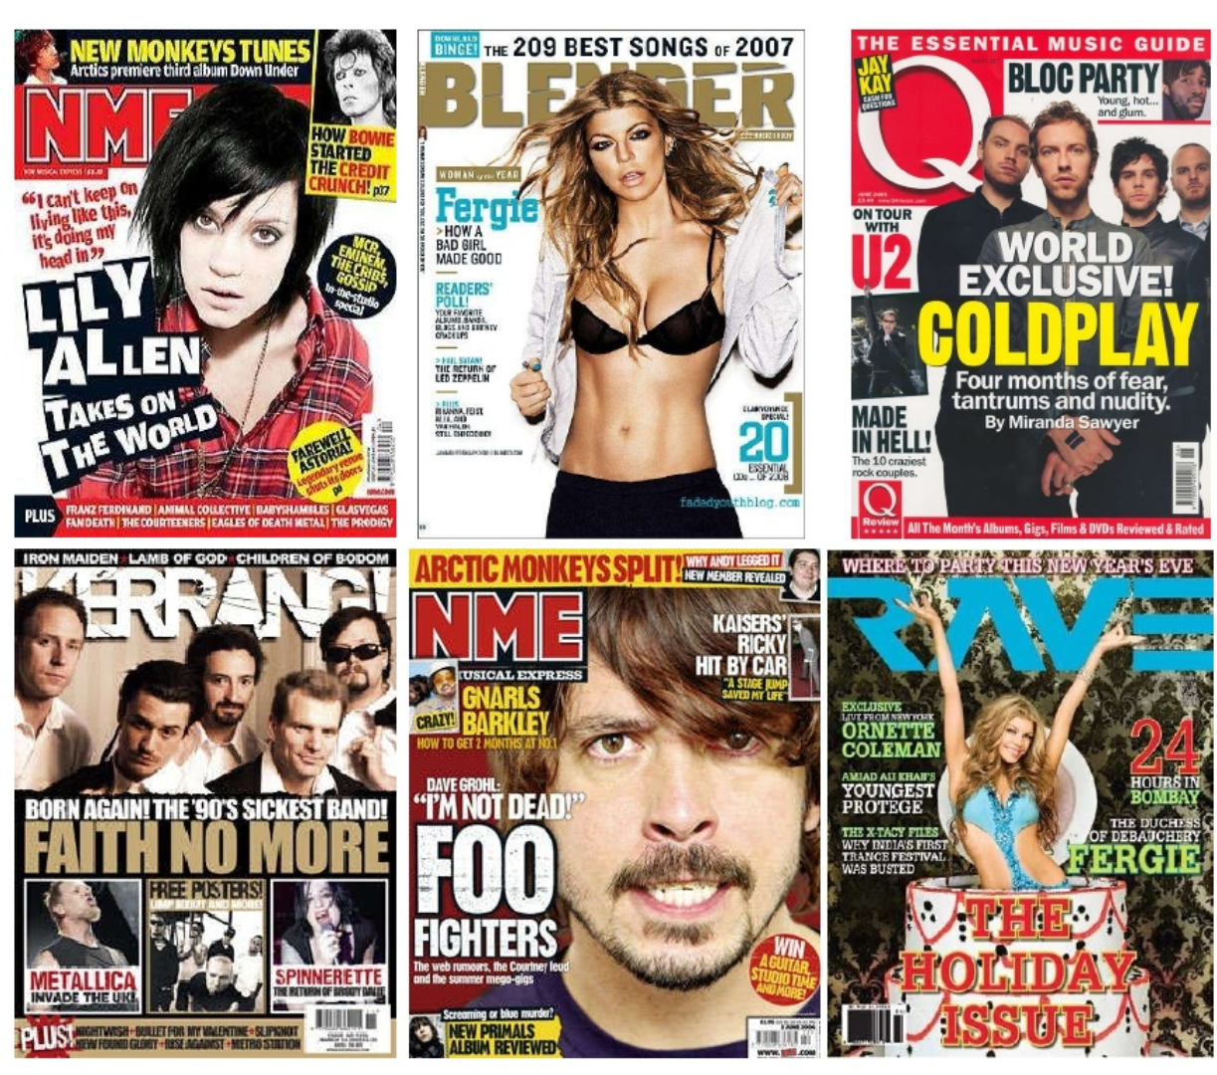
Answer: How do these different music magazines appeal to different target audience?

Slide 14
Profiling the audience – GQ https://cnda.condenast.co.uk/static/mediapack/gq_media_pack_latest.pdf
Answer: What information can you gather about the GQ audience?

Slide 15

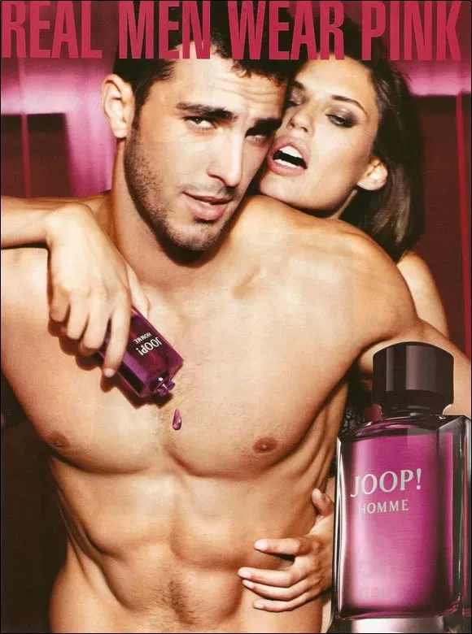
Target audiences (next 3 slides)
1. Who do you think is the target audience for these media texts?
2. How are they targeted and appealed to by the media texts?

Slide 16



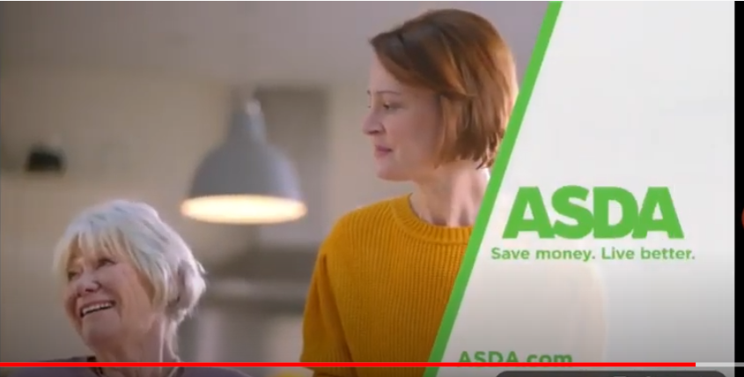
https://youtu.be/ybji16u608U
Black Widow film trailer
https://youtu.be/ybji16u608U
Black Widow film trailer

Slide 17

Sun frontpage, June 2016

Slide 18
Week 5: Understanding Industry

Slide 19
Watch and respond: Film production
https://www.youtube.com/watch?v=e5EoMcoUI2Q
What processes are included in the film making process?
Watch and respond: Film Theory: Should Disney Buy Spiderman for $10 Billion? (Disney vs Sony)
https://youtu.be/K_IHoG1XfoI
Sum up in 4-5 bullet points the key points around ownership dealt with in this video. Use the diagram below first if this helps.

Slide 20
The Film Industry – BBC Bitesize
Industry Terminology
High production values:
Independent film:
Synergy:
Media conglomerate:
Distribution:
Vertical integration:
Horizontal integration:
What are the biggest film studios now?

Slide 21
Independent films
Find at least two examples of independent film companies in the UK.
Find at least two examples of independent productions which have secured mainstream success at the box office.

Slide 22
Film Regulation
Find the BBFC rating for the following films: Avengers Endgame (2019), Joker (2019), Little Women (2019).
For each of the film, refer to the guidelines to explain why the film was awarded such a certificate by the BBFC (You will need to visit the website – one example is given on the next page)
Read this article titled Where have all the 18 certificate films gone?
https://www.denofgeek.com/movies/where-have-all-the-18-certificate-films-gone/
According to the article, what factors have played a key role in the dwindling number of films with a 18 certificate rating?

Slide 23
Don’t forget!
Take the BBC Bitesize test to check your understanding! https://www.bbc.co.uk/bitesize/guides/z9hrwxs/test

Slide 24
Extra tasks to stretch your learning - Optional
You can add to the slides below or you can complete the work on a separate document.

